Slide 1
DBMS Mini Project Review
Title: Student Attendance Management System
Team Details:
Name: Krubasagare K USN: 1CR19IS185
Name: Ronald Ryan. G USN: 1CR19IS121
Name: Puneeth. S USN: 1CR19IS110
Faculty Coordinator:
Ms. Vyshali Rao K P
Assistant professor Department of Information Science.

Slide 2
Table of Contents
Abstract
Literature Survey
Problem Statement
Scope of the Project
System Requirements
Proposed Methodology
Appendix
Conclusion

Slide 3
Abstract
The project “Online Attendance Management System” is implemented to reduce the manual work and enhances the accuracy of work in a college. This project is also designed with full consideration to help the Faculty in an easy manner without any unnecessary wastage of time.
This system can be implemented in Institutions. Online Attendance Management System deals with the maintenance of the student’s attendance details. It generates the attendance of the student on the basis of their presence in class. It is maintained on the daily basis of all particular class of their attendance.
Every single staff will be provided with the separate Email & password to make the respective class's student’s status also. Multiple classes can be added by one particular staff. The staff handling the particular subjects are responsible for marking the attendance for all students.
Only if the student is present on that particular period, the attendance will be calculated. The students attendance reports based on every particular subject will be consolidated and Bar Graphs will be generated.
Now a day’s technology eventually means “computer” which is the greatest achievement of the last century. Today computers are being used in every area because of their features like ease of use, ease of learning, the greater accuracy with the least time consuming, and the last but not least i.e. ease of maintenance with cost-effectiveness.

Slide 4
Problem Statement
Apparently in our today’s world things cannot be done organized, accurately and efficiently using file-based system so making things globally in a digitized way is a tremendous advantage, especially this type of Attendance management system program.
The purpose of developing this attendance management system is to computerized the tradition way of taking attendance. Another purpose for developing this software is to generate the report automatically at the end of the semester.

Slide 5
Scope of the Project
A Window application to be used in place of old paper based.
Eliminate duplicate data entry and errors in time and attendance entries.
Eliminate paperwork and save time.
Automatic calculation of attendance .
To Increase security.
Concrete functionalities with efficiency and accuracy.

Slide 6
System Requirements
Defining and Implementing the System Requirements is one of the important criteria to meet high accuracy with maximum precision as well.
Hardware Requirements (Minimum Requirement)
Minimum RAM:- 4 GB
Processor:- IntelCorei5(2GHZ)or above
Hard Disk:- 4 GB of Free Space
Backup Media:- Hard disk.
Graphics Card:- NVIDIA GEFORCE or AMD (for Animation Effect(optional))

Slide 7
System Requirements
Software Requirements (Minimum Requirement)
Operating system :-Windows 8.1 Home (or above)
Front Design:- Using Sublime Text, Atom IDE
Languages Used:-
1) Front-End: HTML5, CSS, JavaScript, PHP
2) Back-End: MySQL
3) Server Language: PHP 7.2.18
Server:- Wamp Server Version 3.1.964 bit
Back-End:- MySQL Version 5.7.26 (or above) Port 3306
Back-End Connectivity:- Apache 2.4.39 Port 80 & PHP 7.2.18

Slide 8
Proposed Methodology
Master Page
The project starts from the main page, But before going to project directly, we would have to pass through Master Page. The Master page is an interactive and more responsive, which displays the Crew Members description with the help of avatars, Which will rotate over x-axis & y-axis, both at 180°degrees.
Page Sections
There are mainly 3 sections in the Index page:-
• Header Section.
• Login Section.
• Signup Section.

Slide 9
Proposed Methodology
After Login
Dashboard:- Returns to Teacher’s Dashboard.
Profile:- Faculty can edit the Name Phone and Email of own.
Students:- To check result of students.
Statistics:- Displays Graphical view of all subjects.
About:- Description about institution.
Contact:- Provides Contact details.
Insertion:- To insert The students details into Database.
Logout:- To end The Session.
Header Section
This Section is to keep the required field like:-
Before Login
Home:- returns to index page
Students:-To check result of students
Statistics:- Displays Graphical view of all subjects
About:- Description about institution
Contact:- Provides Contact details
Login:- To Start the Session.

Slide 10
Proposed Methodology
Signup Section
This section provides the New Faculty who have not registered yet, they can Signup with the required fields. Every field must be required to signup. Then, As soon as the signup is done the following email and password will be automated, as that will appear in the login section so as to reduce time
STUDENT DASHBOARD
The Student will have the permission to Check their Attendance, Performance with Graphical representation of Bar Chart Based Subject Wise with Subject Code and their University Seat Number a.k.a USN.
FACULTY DASHBOARD
The faculty have to login before, to access all the modules inside the Application. After Login, He/ She must need to create the class to take the attendance, the Dialogue or Prompt appears on screen As He/ She click on the + from the session.

Slide 11
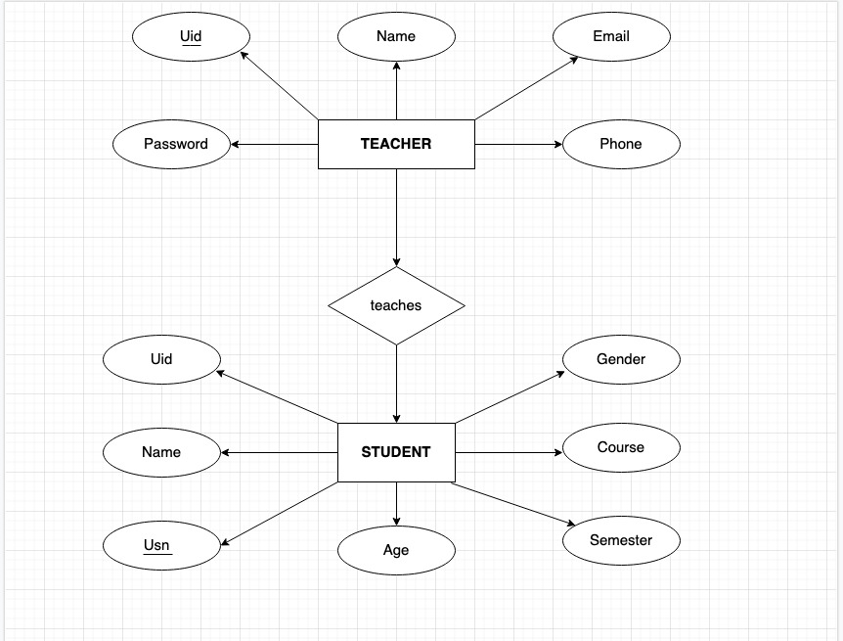
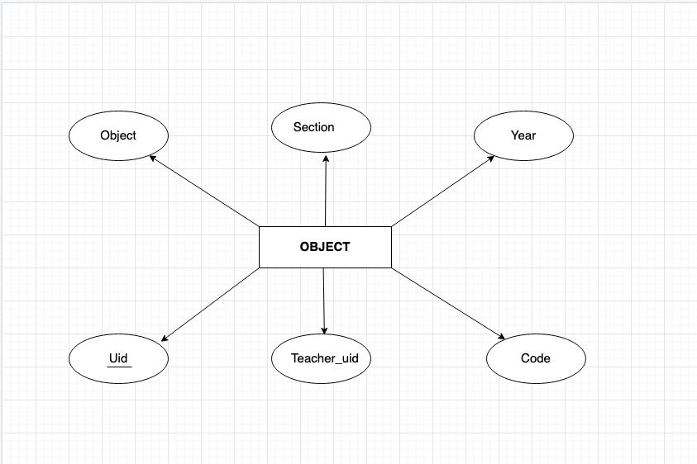
Entity Relationship Diagram

Slide 12
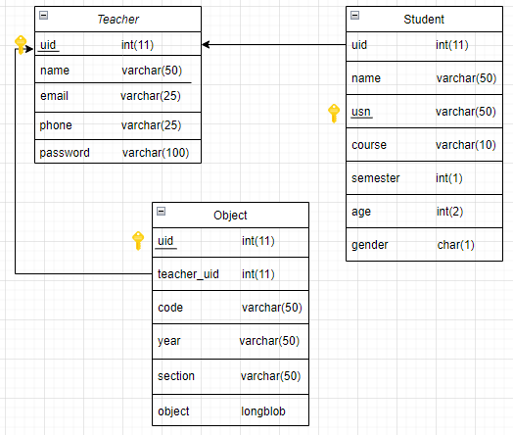
Schema Diagram

Slide 13
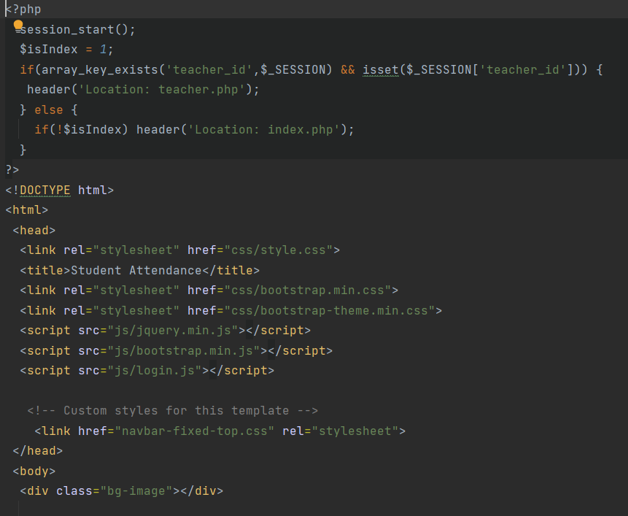
Appendix

Slide 14
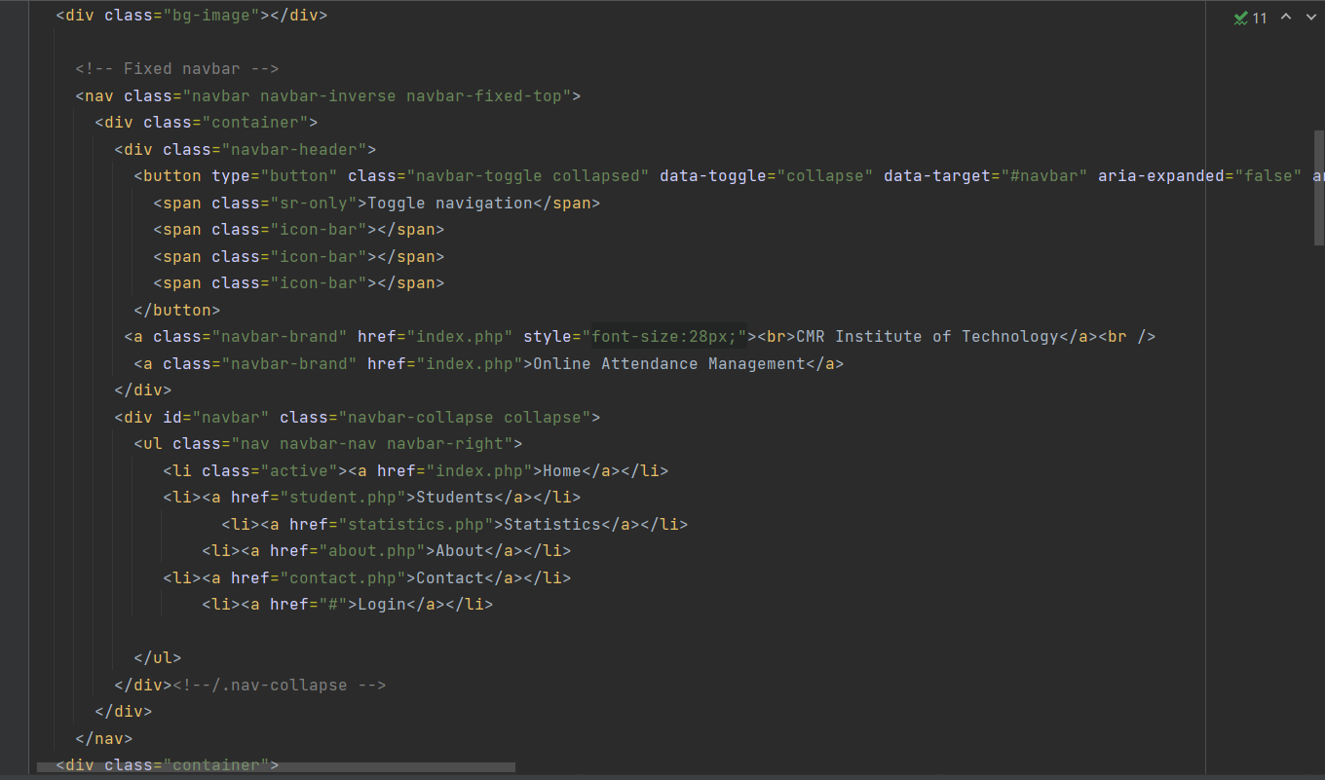
Appendix

Slide 15
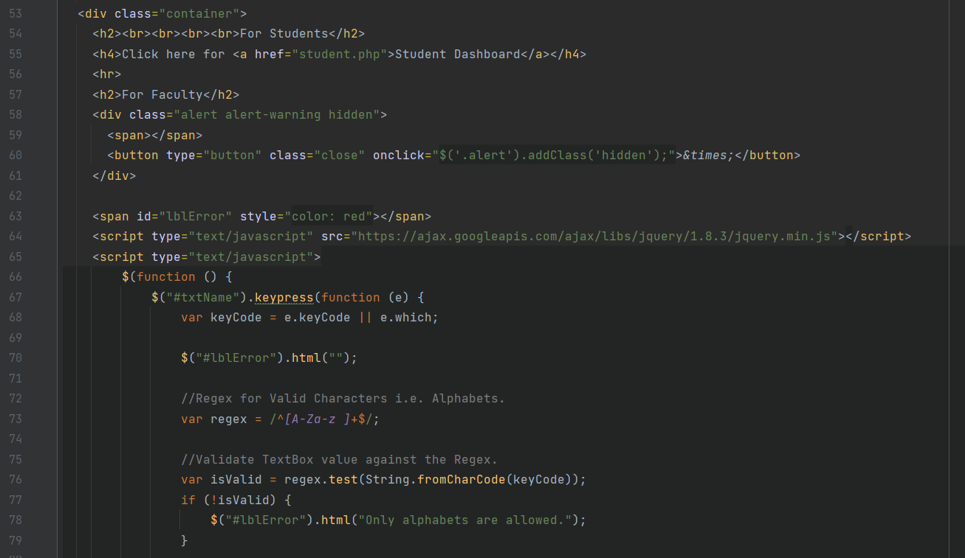
Appendix

Slide 16
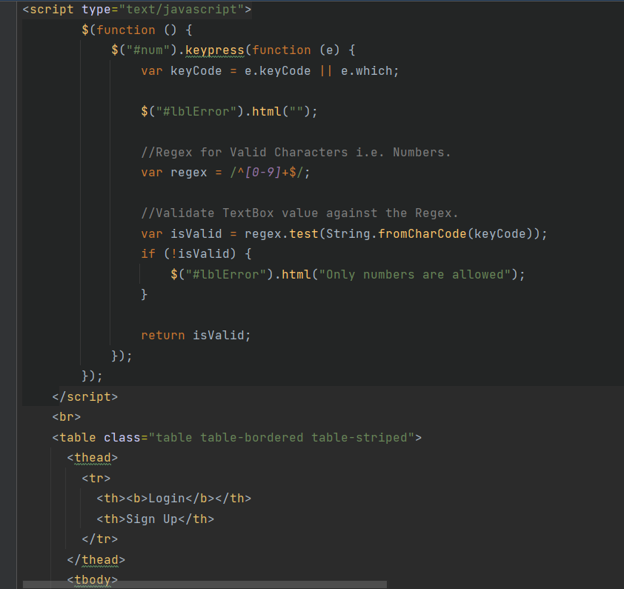
Appendix

Slide 17
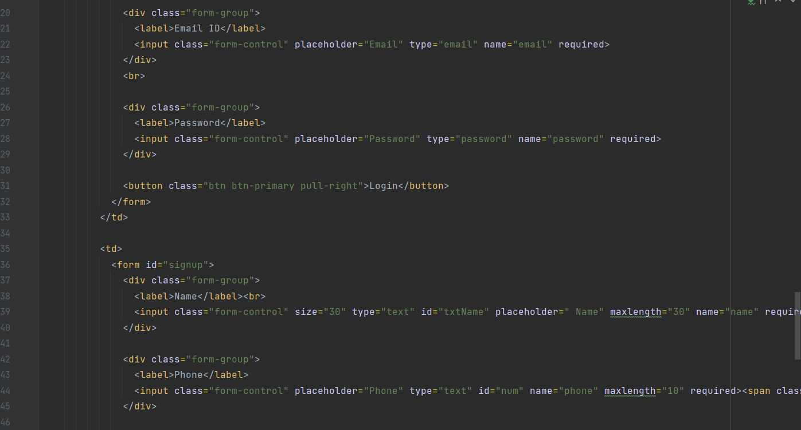
Appendix

Slide 18
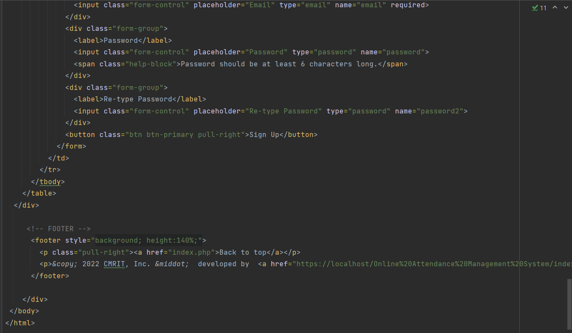
Appendix

Slide 19
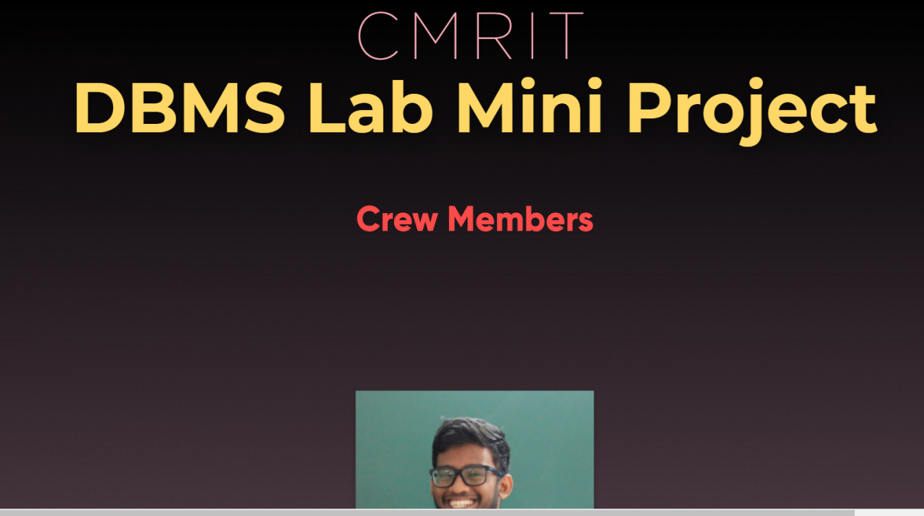

Appendix

Slide 20
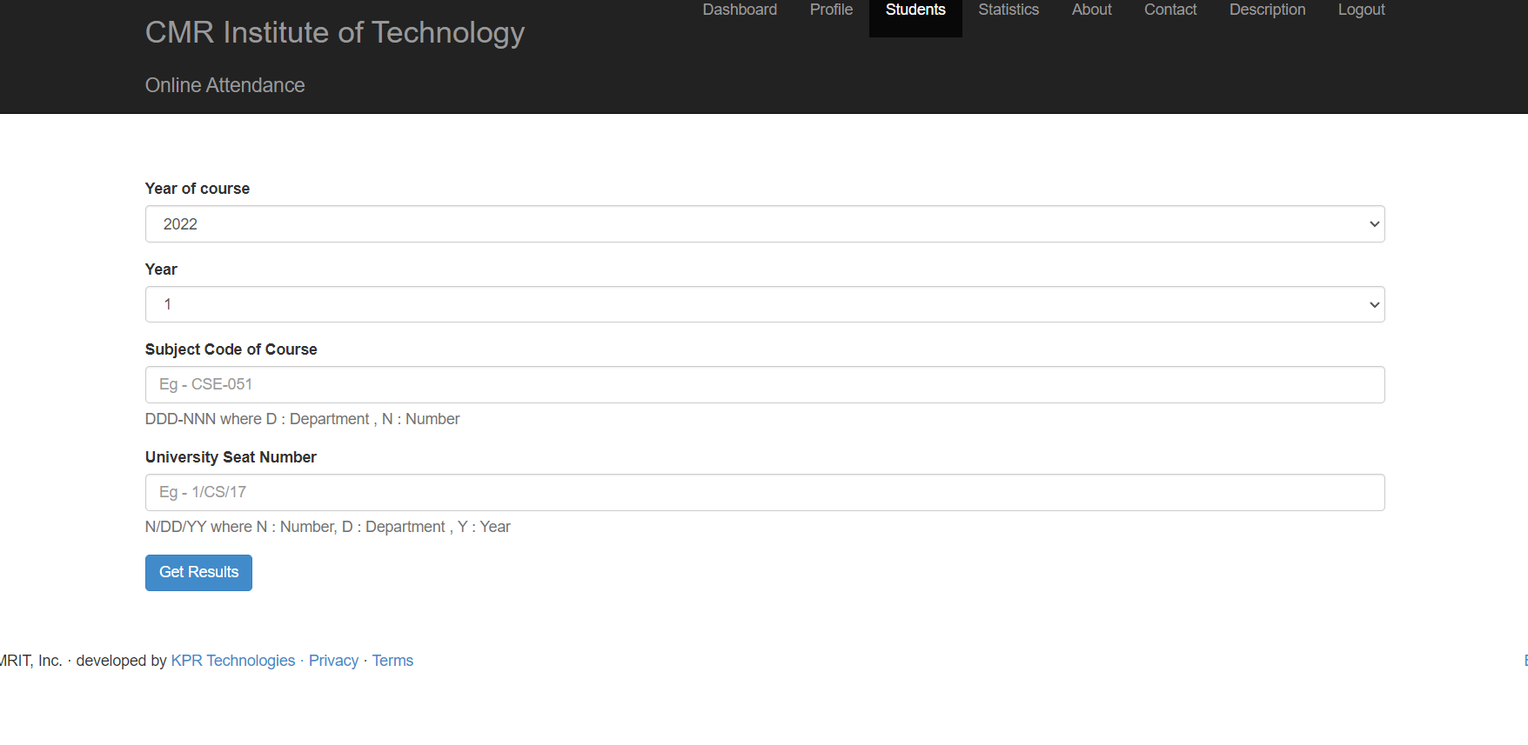
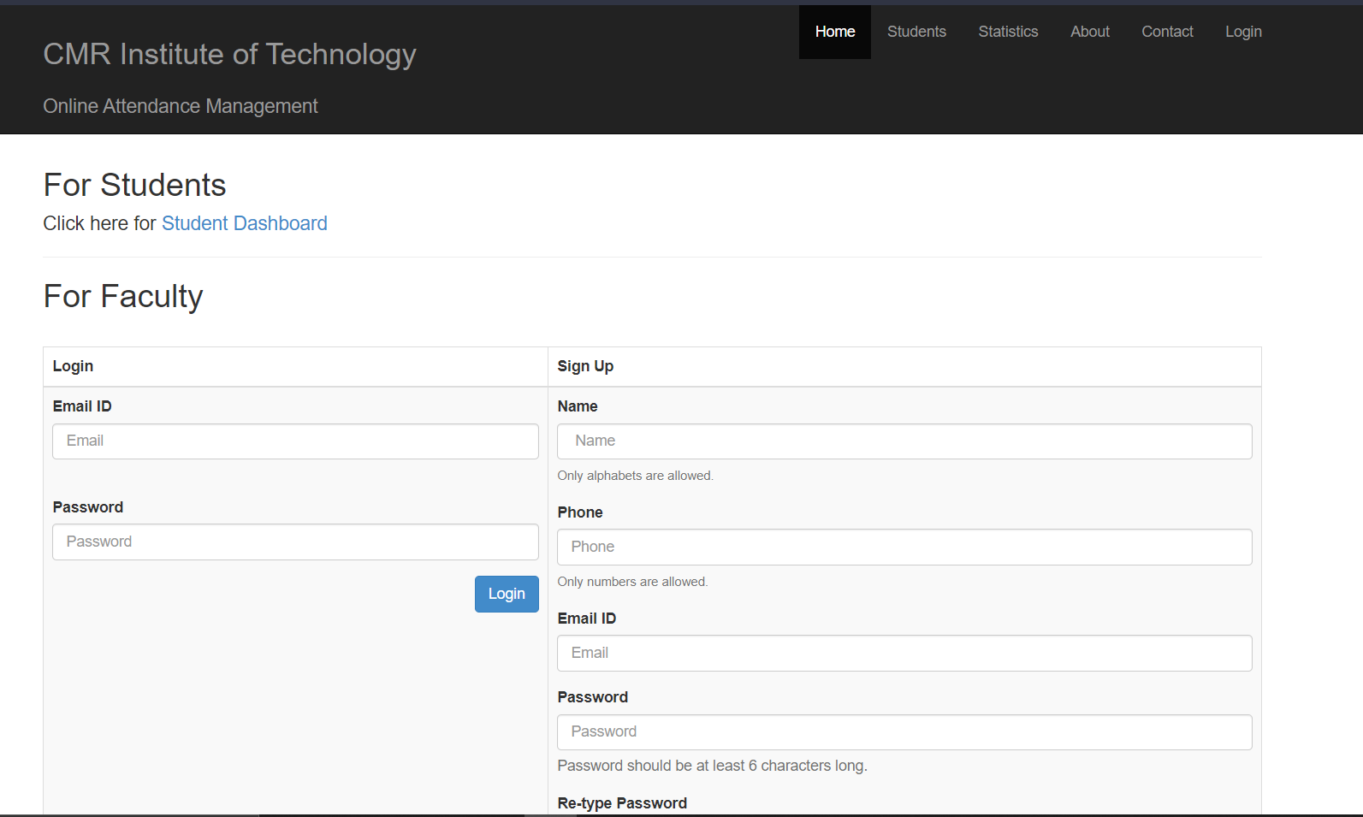
Appendix

Slide 21
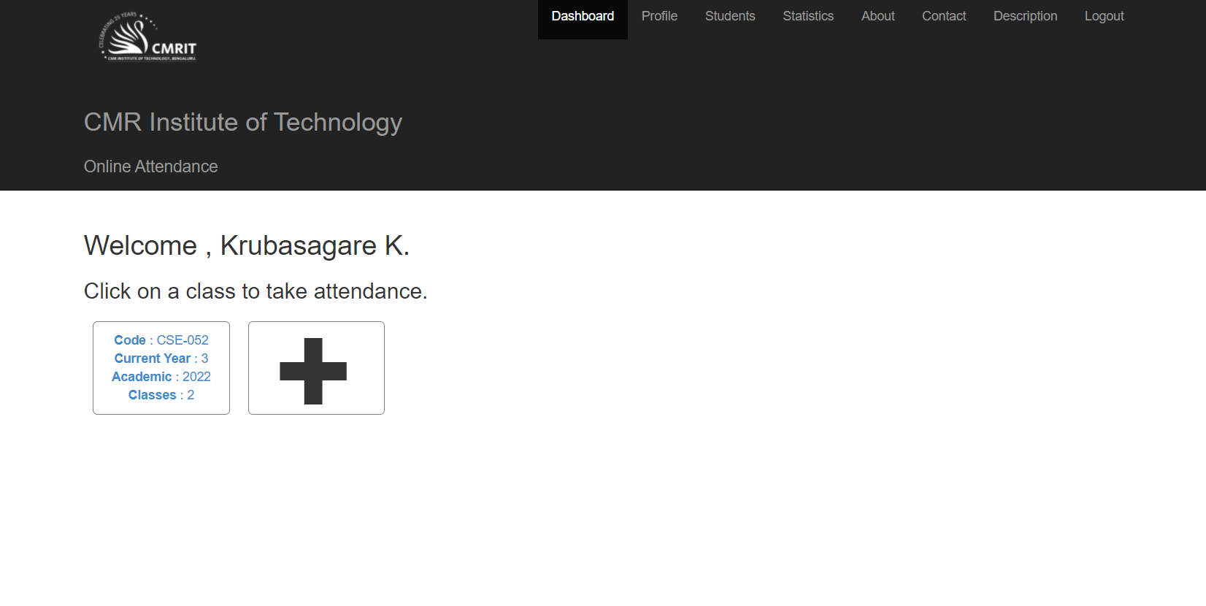
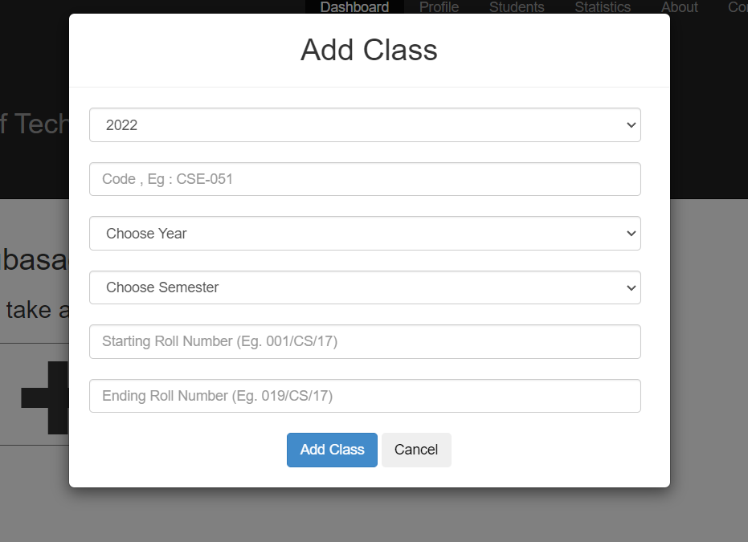
Appendix

Slide 22
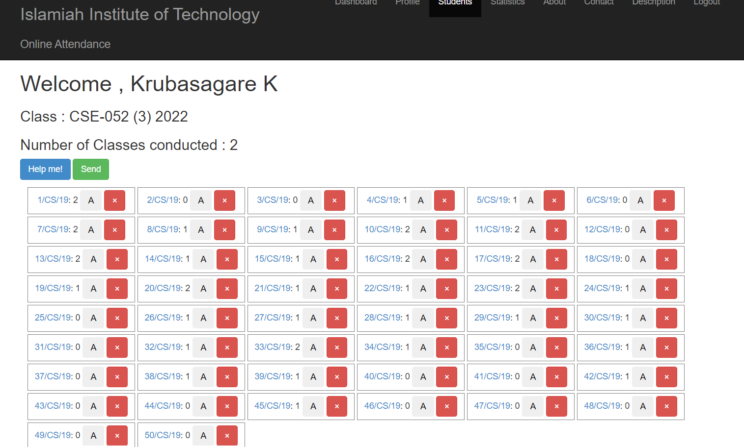
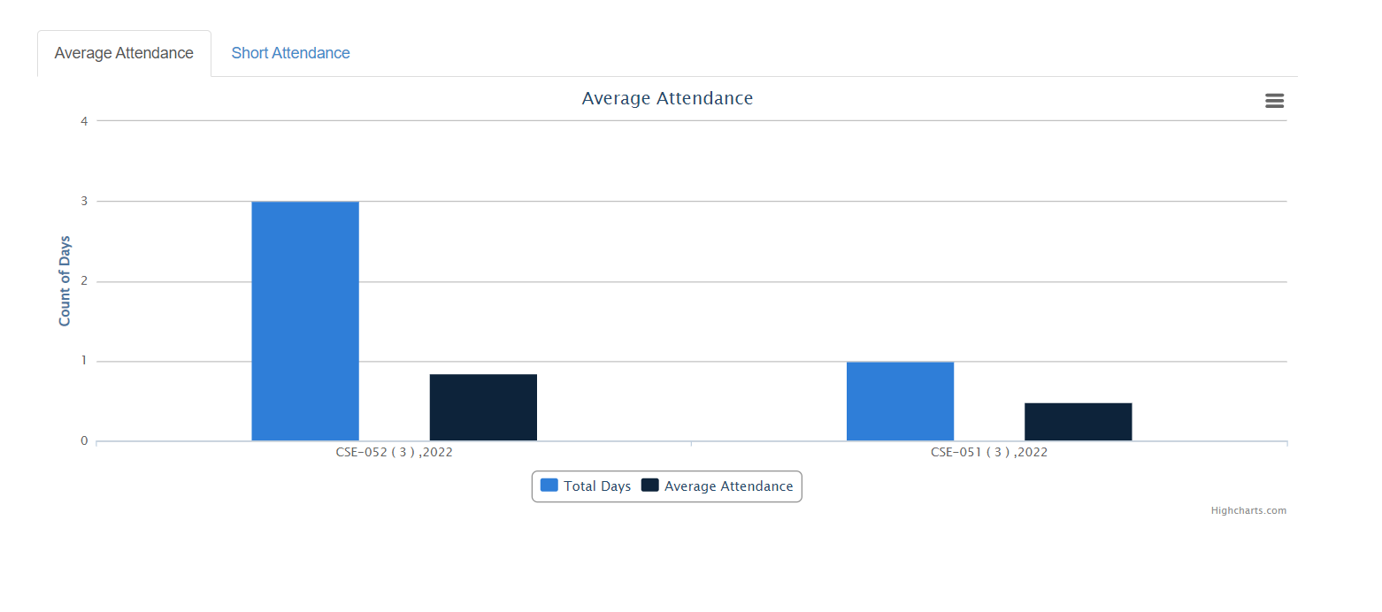
Appendix

Slide 23
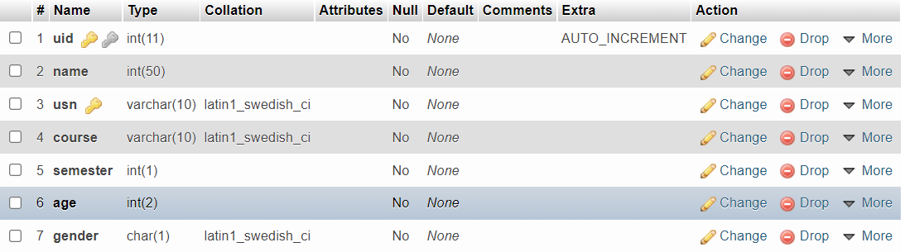
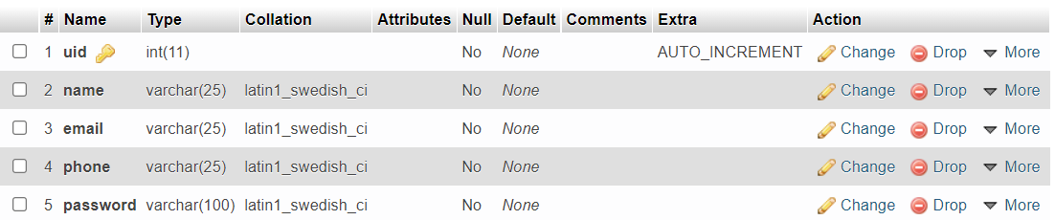
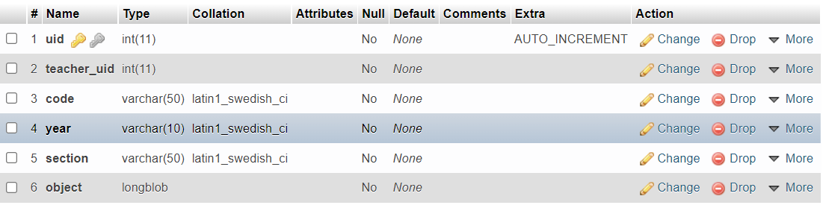
Appendix

Slide 24
Conclusion
To conclude, this project basically streamlines the process of maintenance of the Attendance of students, similar to the existing ERP’s in multiple colleges. Providing an interactive interface for the project makes it easier to use and providing certain extra facilities makes the project better than some it’s contemporaries. We believe that multiple additions can be made to this project. It’s not yet reached the peak of what it can be. But, given the time-frame and multiple constraints, we felt that this was the best implementation of our idea that we could present at this point of time.
THANK YOU!!!

